Slide 1
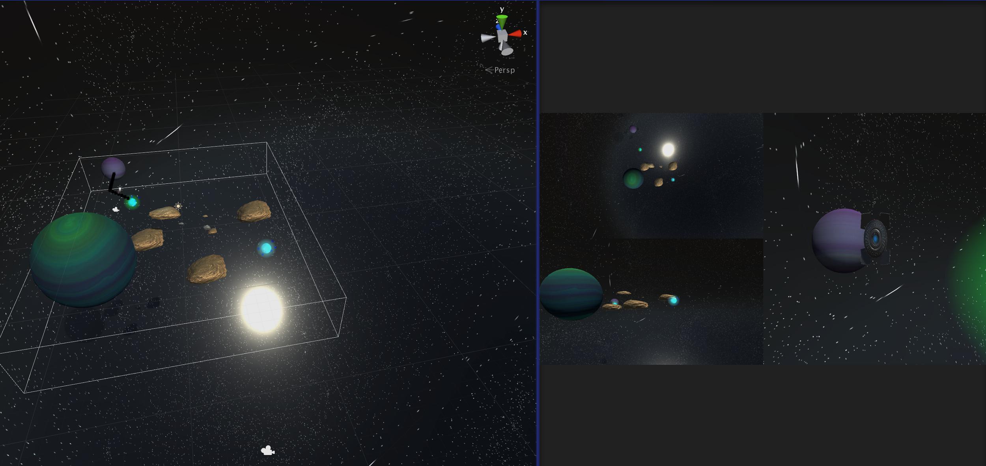
3D A*... in space
Samara Fantie [coordinator]
Rehaf Aljammaz [implementer]
Brittany Williams [documentor]

Slide 2
Overview -
-Goal
-Environment
-Gamespace
-Additions
-Heuristic & Move cost

Slide 3
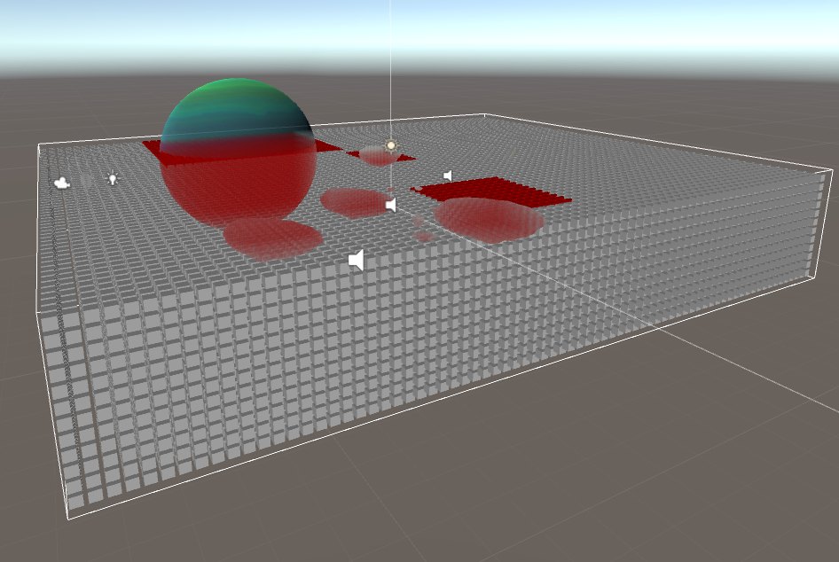
Tech overview
Unity and c#
Grid layout and node representation in a 3dspace
a*
Resetting and choosing goals /porters vs goal
directly via path
*attention to return / break statements - infinite loops
Notes:
The story of the development process. At what points did you encounter problems or make triumphs?
Changes in focus to make the project tractable or of better quality.
What unexpected challenges did you encounter?]
Grid layout - 3d - issue with node representation and diameter size
List stores teh vector returned by the a star as nodes
Ineeficant r8 now
Debugging via debug statments and gizmo shapes and colors
Not really dynamic - thats d*

Slide 4
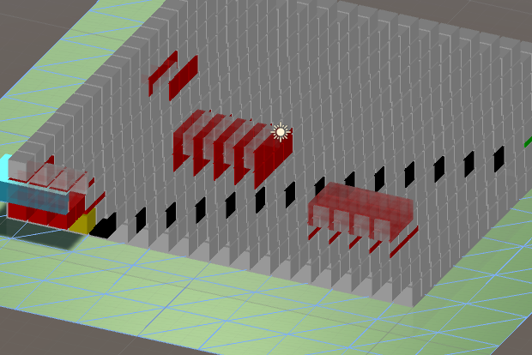
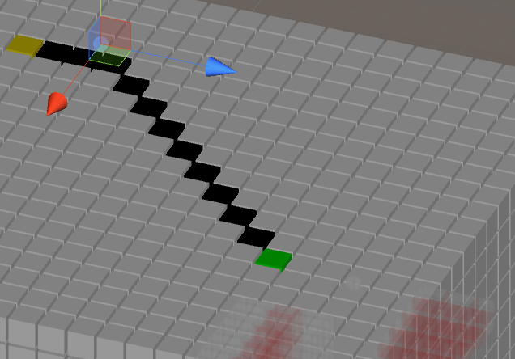
Things to think about
Representing the path and moving the object
Saving vector positions in place of nodes/ list of vectors
Moving the bot
Debugging tools
Finding out where the bot/ objects are represented in the Grid - Debugging - yay for gizmos and colors

Slide 5
Documentation overview
Inline documentation between team members
Comments for team members and explanations
http://www.thetechart.org/default/img/articles/201503/1KyounghwanKim.pdf
Git documentation ‘read me’ file https://github.com/rj-90/AStarProject
Open to the public for viewing
Full explanation of how the A* process works
Notes:
[Explain how your documentation and access criteria were met. If they were not met, what were the problems? What amendments were made?]

Slide 6
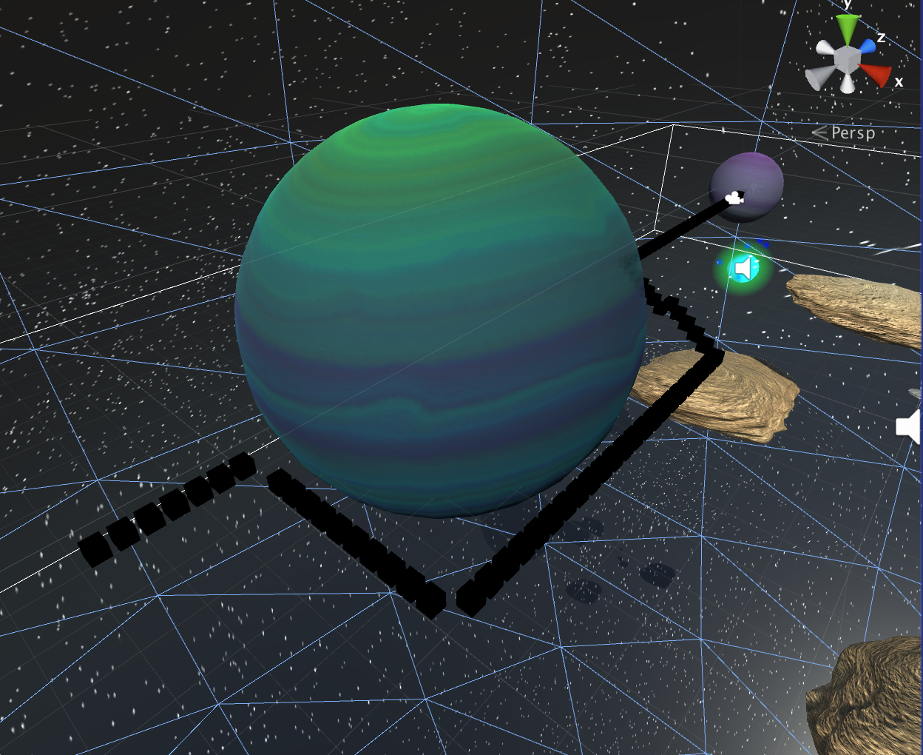
Testing …!
Debug logs...debug logs for everything
Testing the heuristics by moving prefabs
Camera Angles to manage collision

Slide 7
Analysis & Summary-
-Not optimal but is a working A* implementation
-Grid/node size significantly affects running time
-Node sizes directly affect quality of path & wall touching, but smaller= slower
-Transporters have clear effect
-Gravity effect depends on complexity of environment

Slide 8
Lessons Learned-
-Know your environment
-Unity’s debugging tools <3- no coding past 4 am kids
-Easy in theory ≠ easy in practice
-Pseudocode and planning beforehand
-Language translation
-Make a plan and use resources -> 3d paper on representation vs 2d
-Keep calm and use printlines
-Teamwork makes the dream work :-D

